Slide 1
ME 360 Teaching Demos
Conceptual Design Review
Nathan Kim
Note - this deck was a preliminary iteration of ideas presented to the FA2023 instructional team for feedback. Saving it for posterity; note the design has changed quite a bit since this presentation was delivered.
-Nathan Kim 1/4/2024

Slide 2
Frequency Response Demo - “ME 360 Single Degree of Freedom”
Overview:
Single degree of freedom mass-spring-damper with base excitation
Motion input provided by slider-crank mechanism driven by 12V DC motor
User input:
Knob to vary excitation frequency
Easy to change masses, springs with different constants, dampers with different constants
Learning Objectives:
Students can vary system parameters and sweep frequencies in a very tactile way to build an intuitive understanding of second order system frequency response

Slide 3
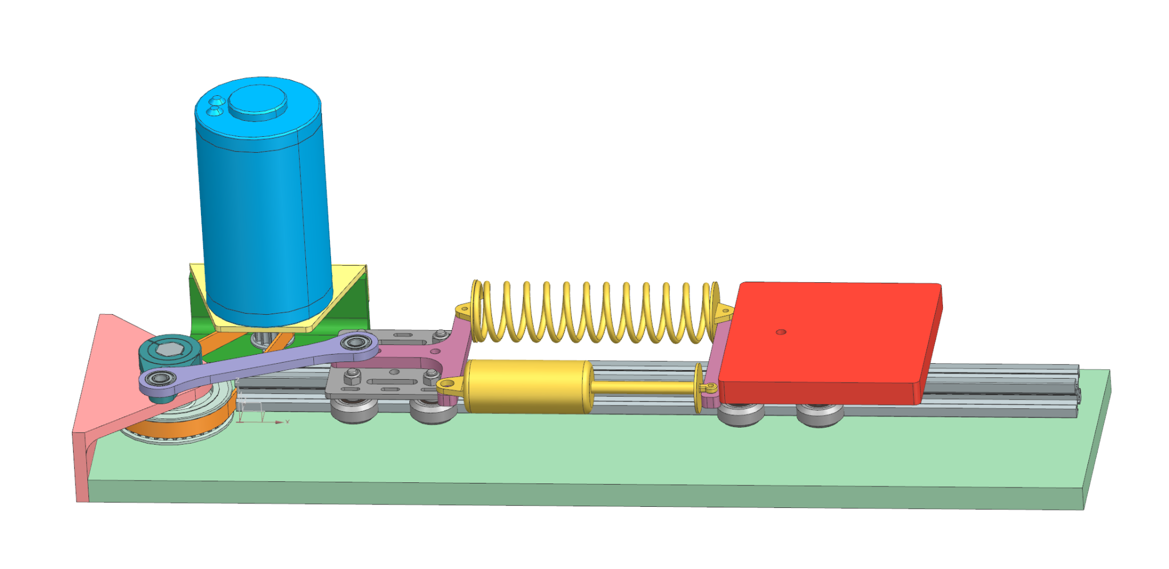
SDoF Mechanical Assembly
Drive system is modular; belt is tensionable through pivoting of this module
System parameters fastened with bolts + wingnuts for relative ease of adjustment
Performance RC car springs and dampers
Square mass plates can be stacked
20” long x 5” wide, 0.5” thick Al plate base with plenty of room to be clamped to a table
Al extrusion linear rail + gantry plates with ball bearings constrain motion along DoF

Slide 4
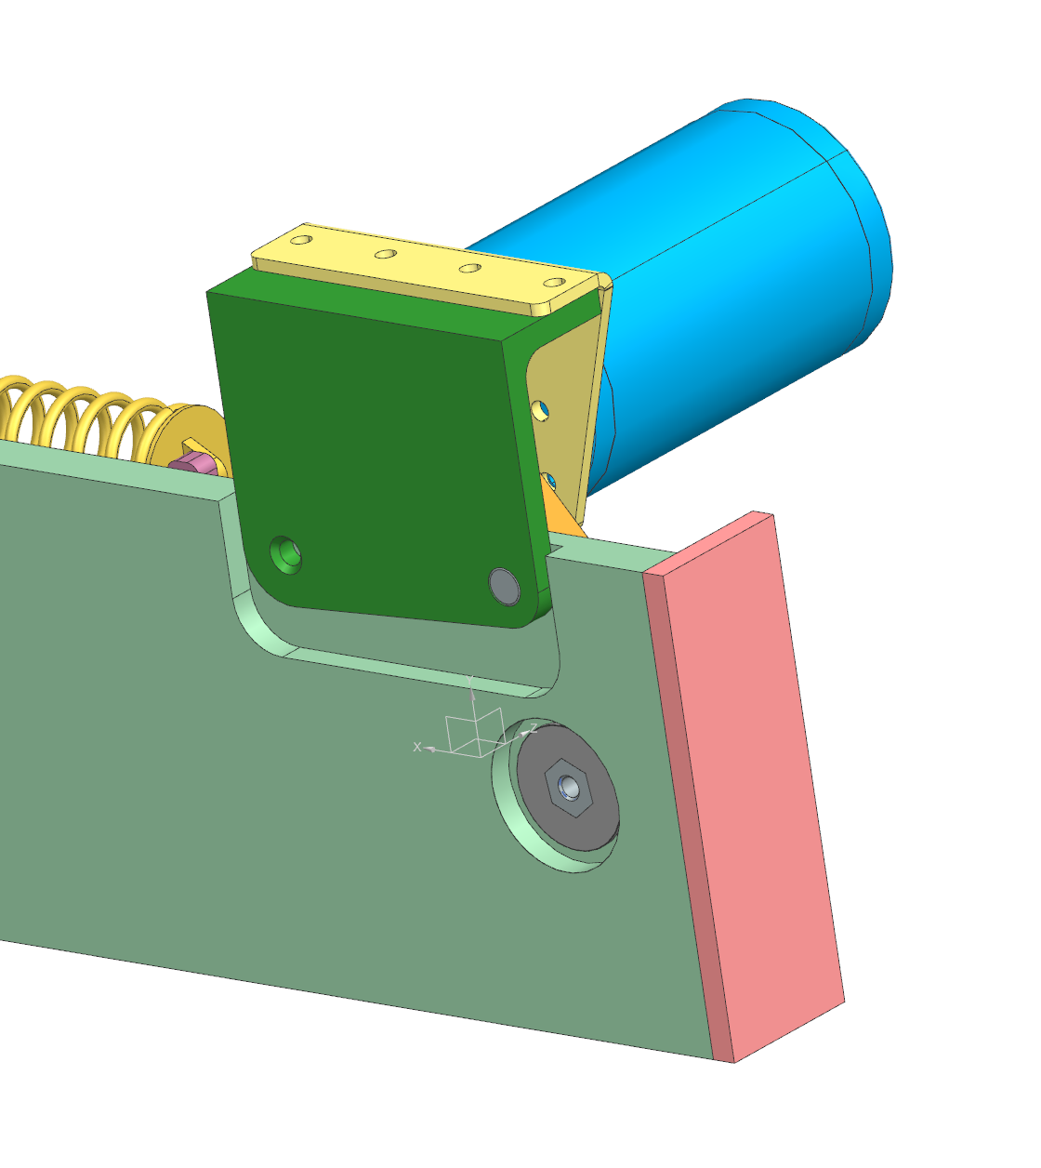
SDoF Mechanical Assembly
Pocketed base plate allows for underside hardware mounting while still sitting flush on a surface
Precision dowel pin provides pivot point for drive module, allowing for belt tensioning

Slide 5
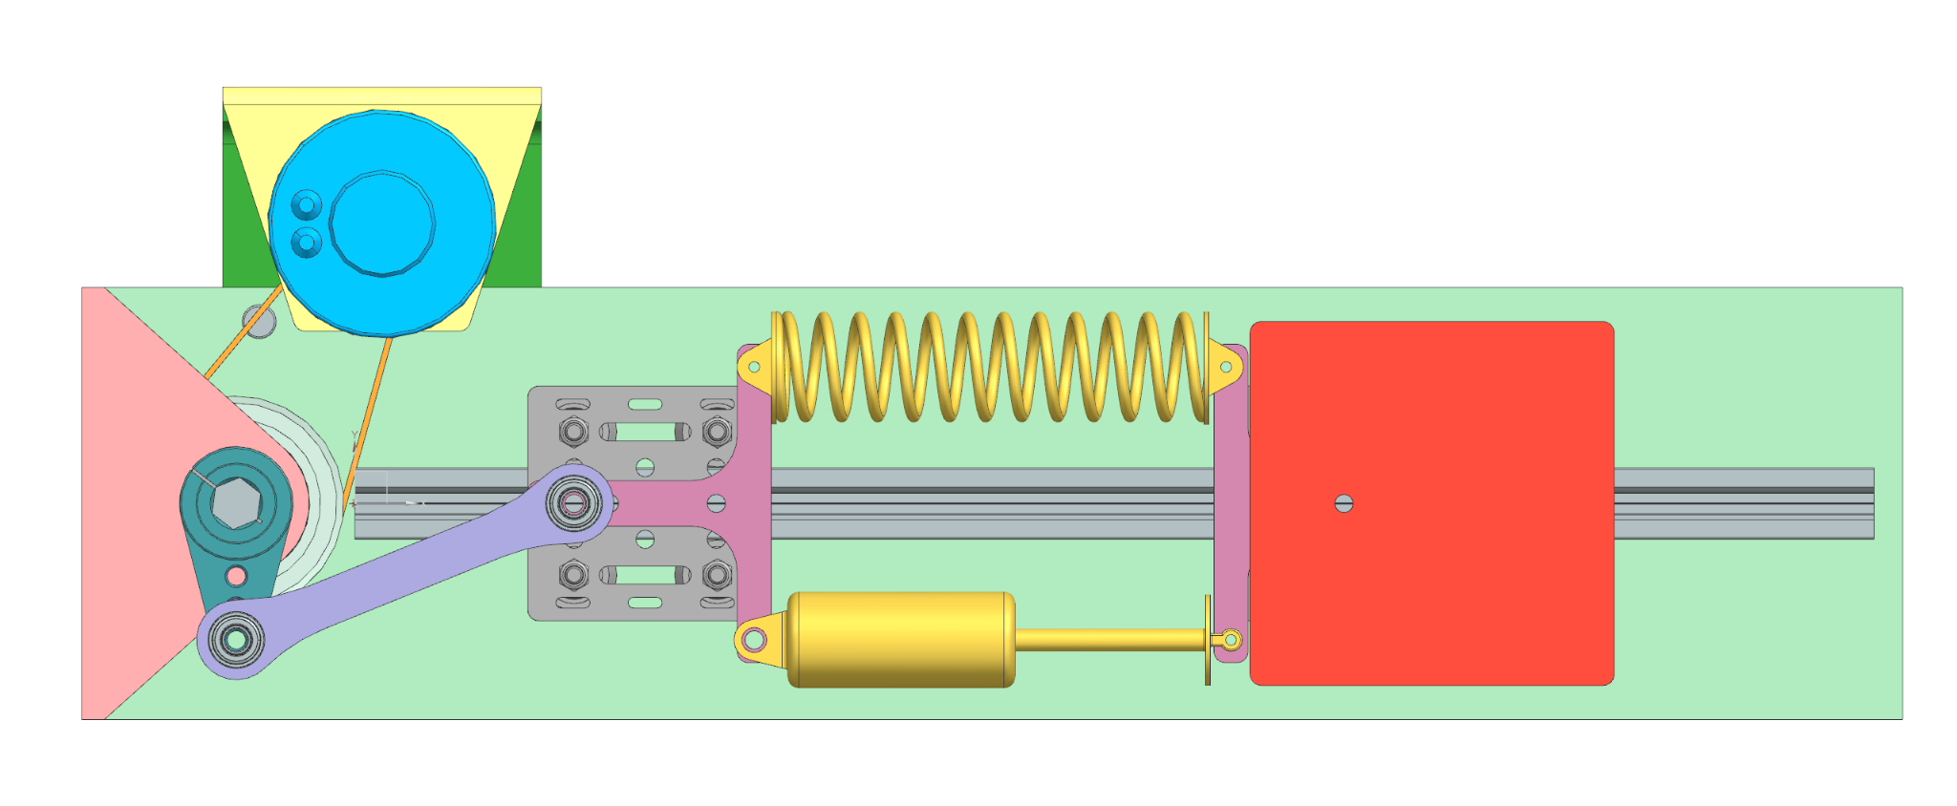
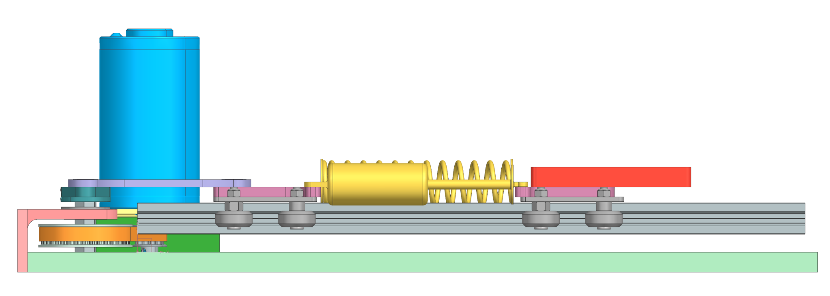
SDoF Mechanical Assembly

Slide 6
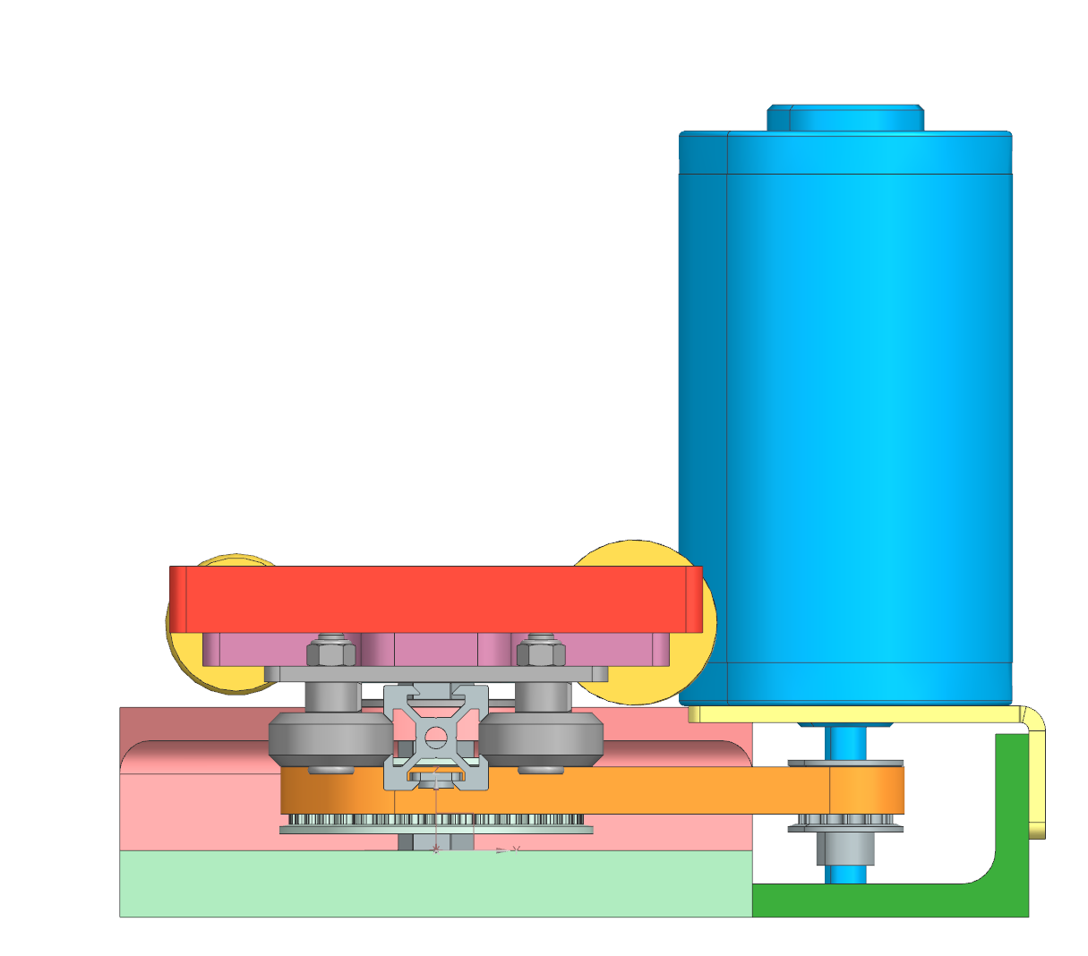
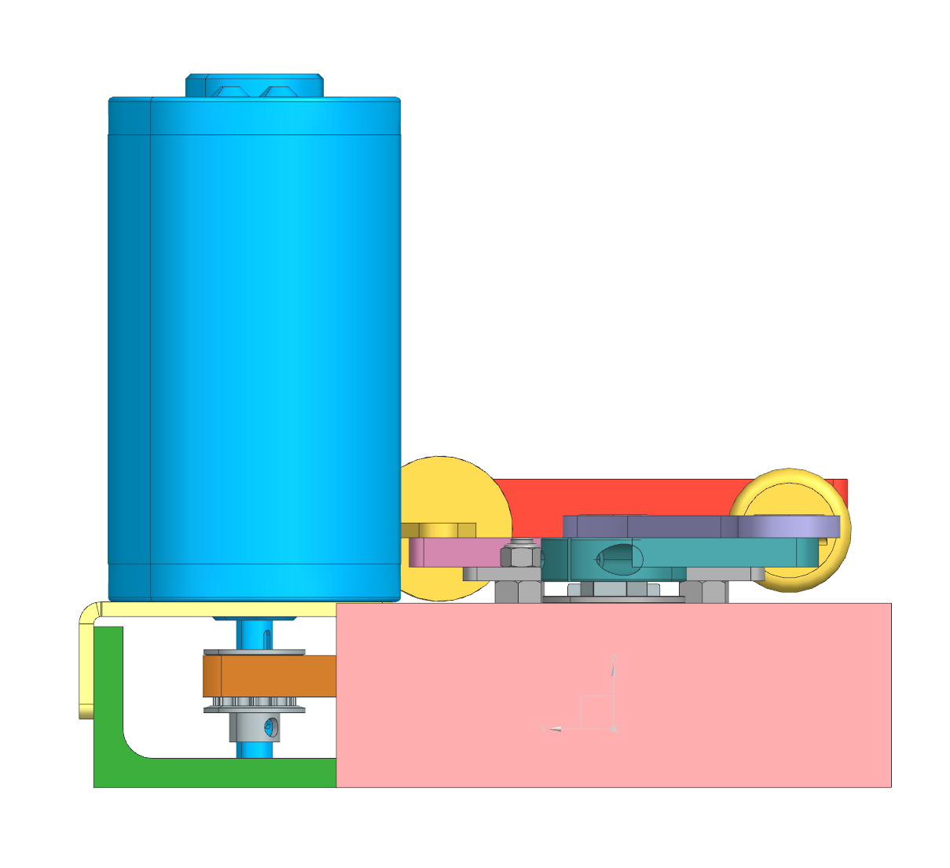
SDoF Mechanical Assembly

Slide 7
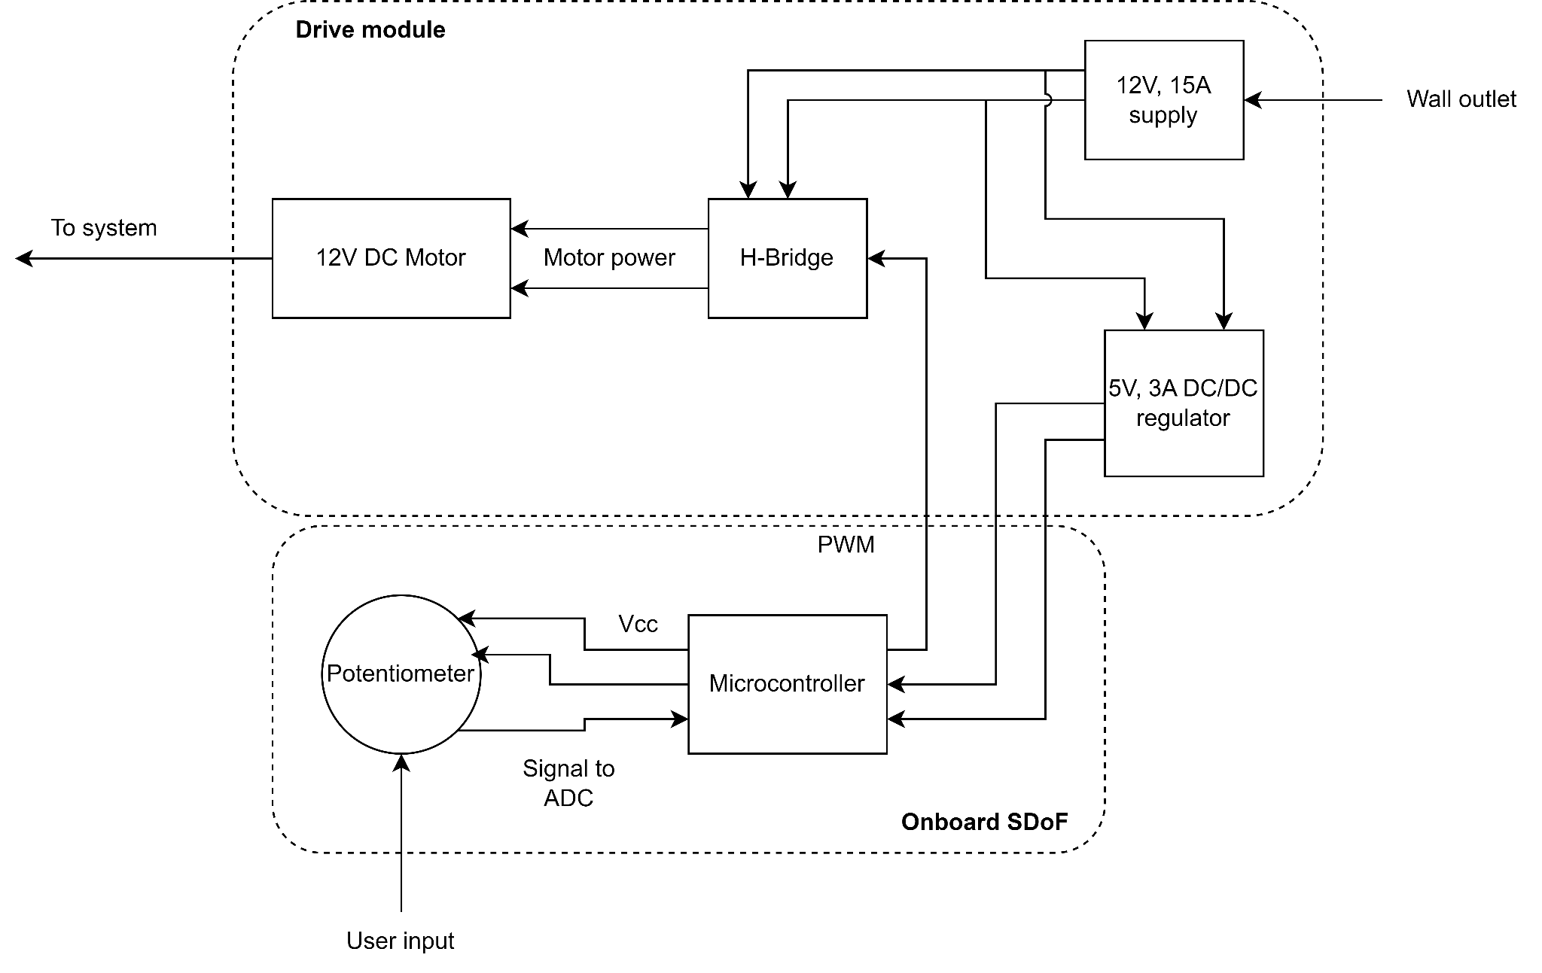
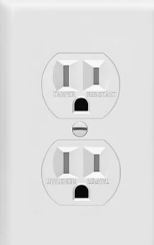

All electronic components are available as generics on Amazon
SDoF Electronics
Drive module allows drop-in compatibility with control box demo
Enclosures will be designed/fabricated after function is verified

Slide 8
PID Controller Demo - “ME 360 Point-a-Tron” - awaiting better alt
Overview:
Single degree of freedom position control
Drive module shared with SDoF demo
User input:
Knobs to adjust controller gains
Hand positioning of reference position
Learning Objectives:
Students can vary controller gains in a tactile way to build an intuitive understanding of how PID gains affect controller performance

Slide 9
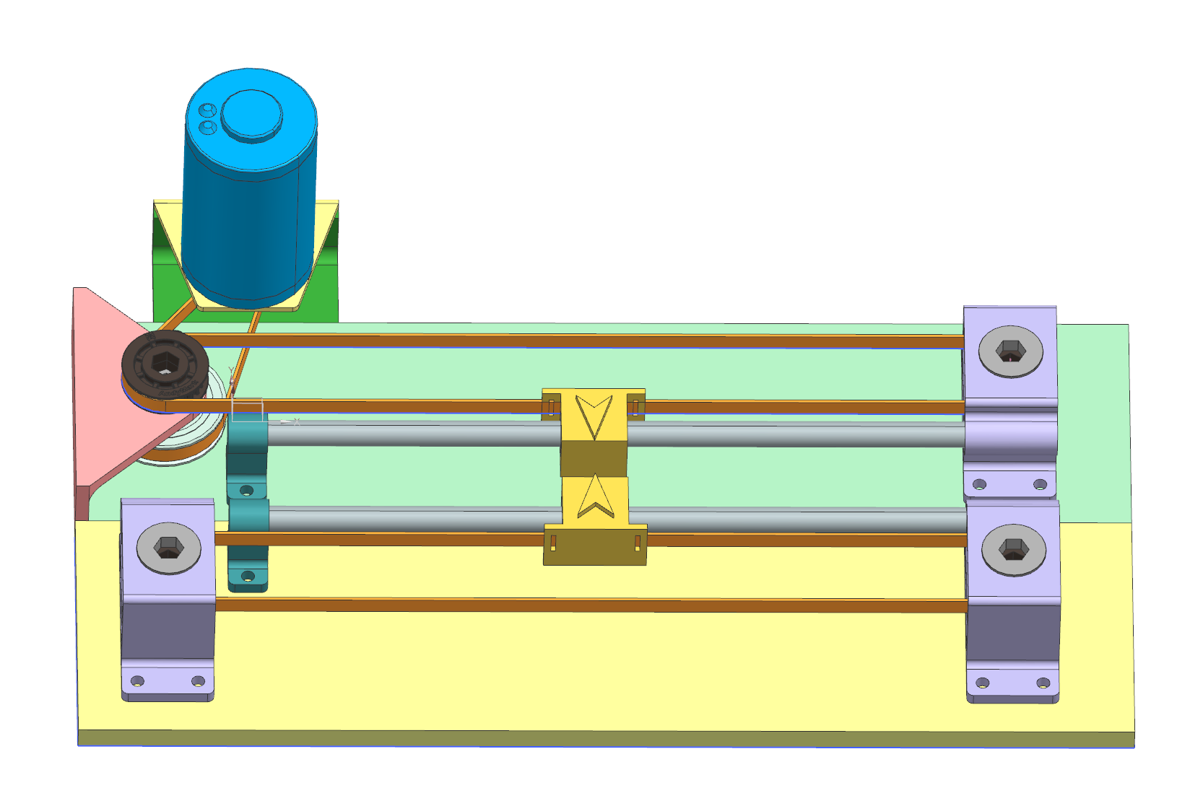
Point-a-Tron Mechanical Assembly
Exact same drive base as SDoF, so only 1 needs to be built
Belt-driven 3D printed pointer rides motion rail
Low loads means all support structures can be 3D printed
Reference input rail structure is a mirror of controlled output structure

Slide 10
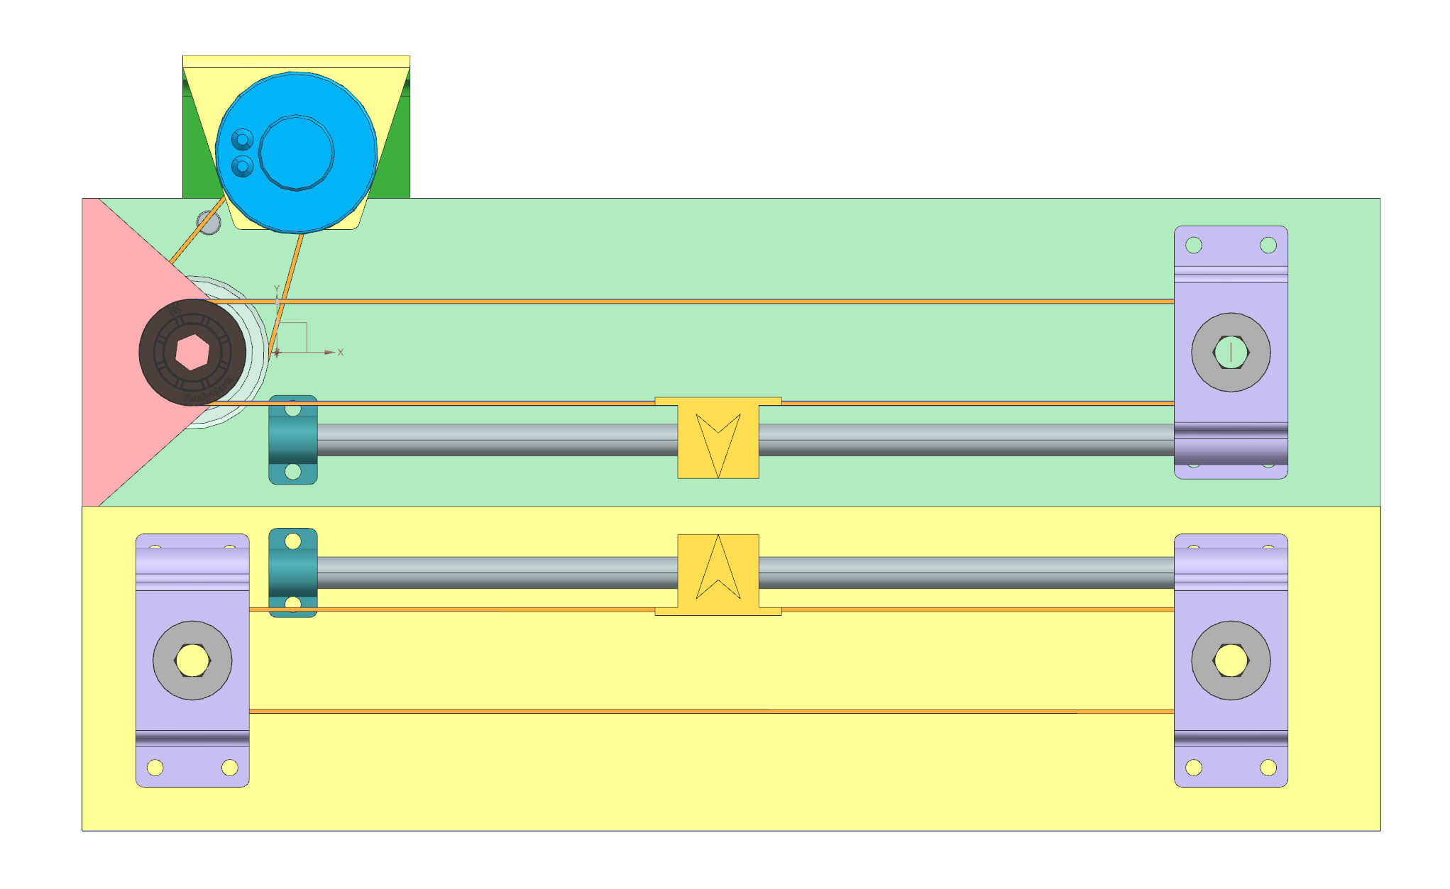
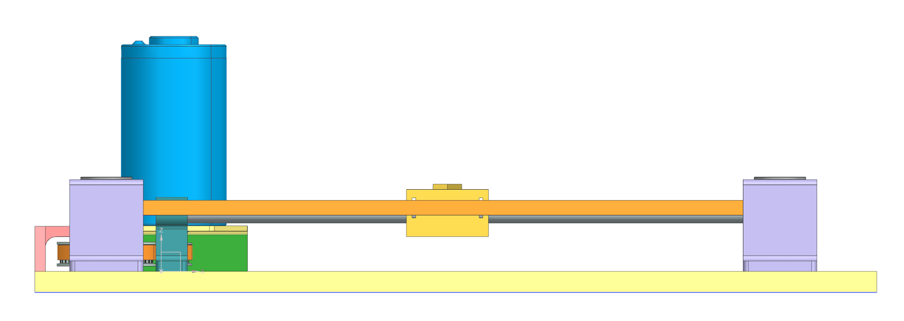
Point-a-Tron Mechanical Assembly

Slide 11
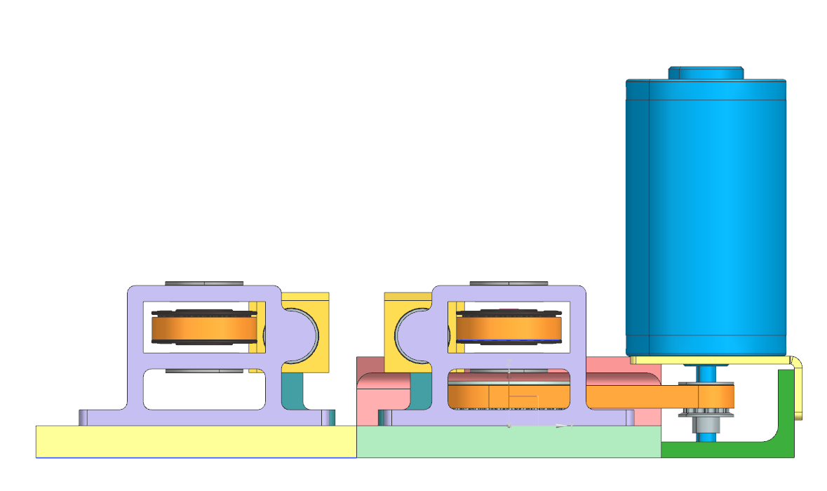
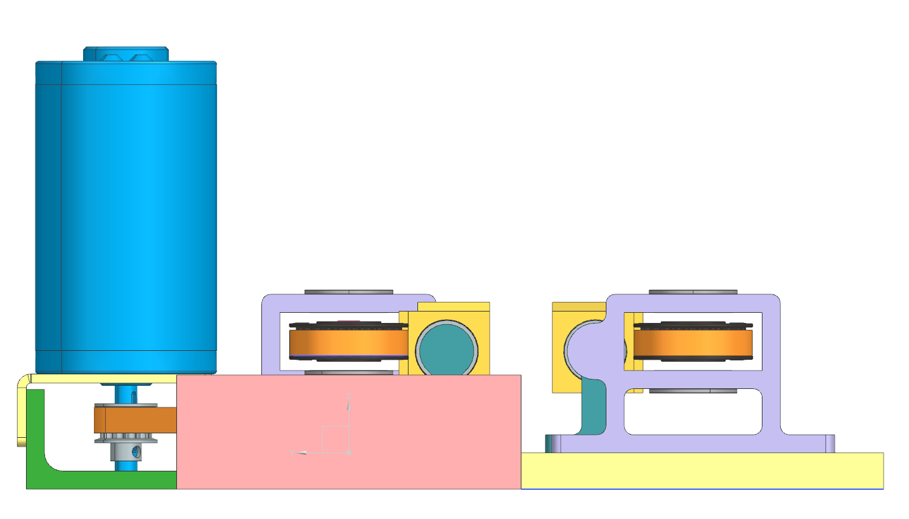
Point-a-Tron Mechanical Assembly

Slide 12
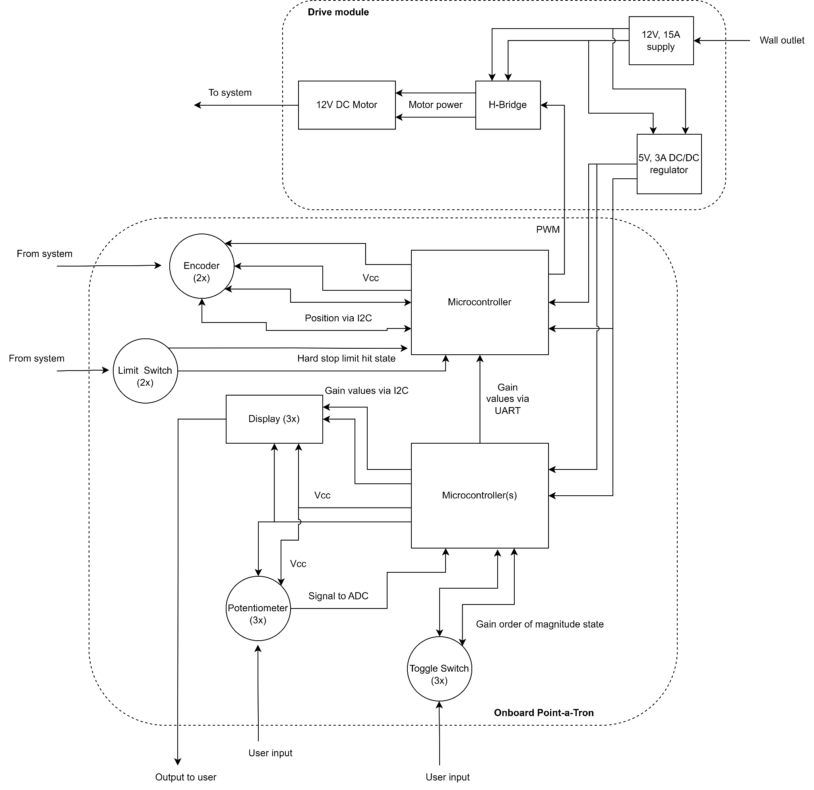
Point-a-Tron Electronics
Lots of displays to drive, inputs to deal with, so baselining multiple microcontrollers- might be able to get around this by daisy-chaining I2C
Enclosures will be designed/fabricated after function is verified

Slide 13
Path Forward
Incorporate feedback
Finishing touches on CAD
Final hole patterns and fastener sizing
Higher fidelity spring/damper models
Switch/knob mounting structures
Cut a BoM + get parts ordered- order ready to go out by next Friday for SDoF parts

